Slide 1

Student Record Management System
By:
Om Narayan Sharma (181500839)
Kanhaiya Bhatt (181500305)
Badal Bhatt (181500187)

Slide 2

CONTENT
Introduction
Problem Statements
Functionality of Student Record Management System
Implementation Details
Snapshots
Future Work
Conclusion

Slide 3
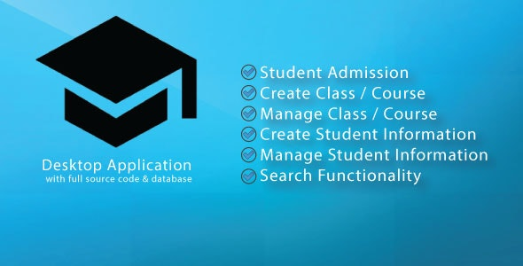
Introduction
This project completely functions for showing it as a prototype to anyone or to showcase in college projects.
registering the Admin, Login Features, Adding Student, View Students, View Students details, View Student terms marks Edit/Modify the student, Delete Student from the record.

Slide 4
Problem Statements
Using manual system to manage the students which are records all information and in the book or paper was causing the job of the teachers becomes more and troublesome.
The record in the have a possibility missing or destroy when happen any accident.
While now already have the school use the computer to manage the student information, but both of the systems they use are already out-dated.

Slide 5
Functionality of Student Record Management System
Add Student
Update/Delete Students
View Students Details
Add Course
Update/Delete Course
View Course Details
Add Subject
Update/Delete Subject
View Subject Details

Slide 6
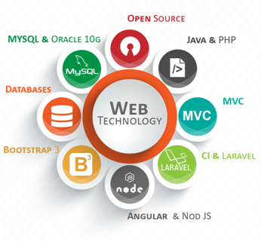
Implementation Details
Intellij IDE – As an integrated development environment(IDE).
HTML, CSS, JavaScript - For front end development
PHP- For back end development
MySQL- For database

Slide 7
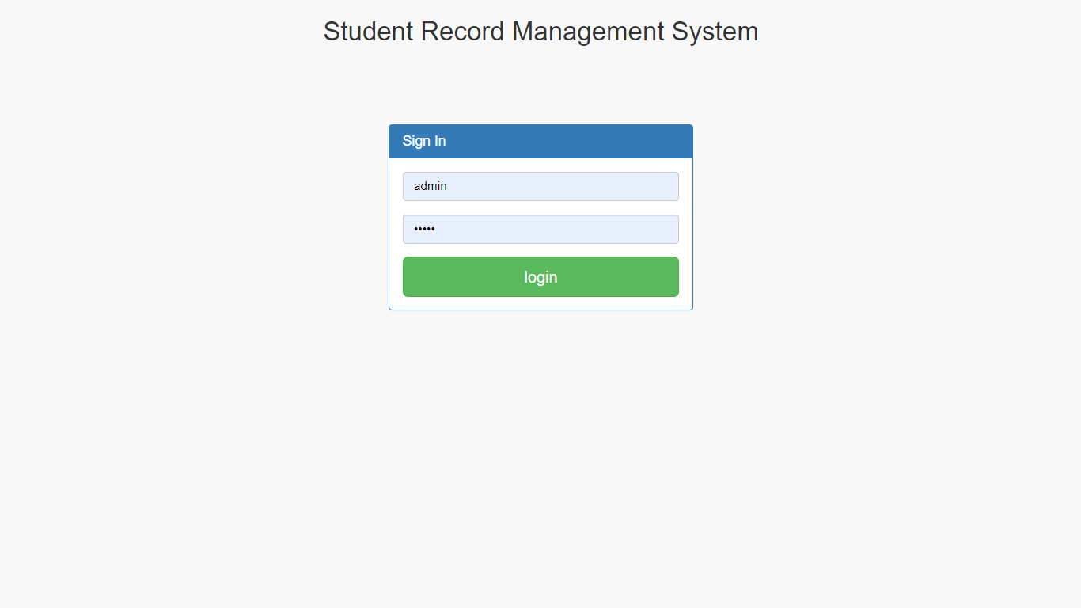
Snapshots: Login Page

Slide 8
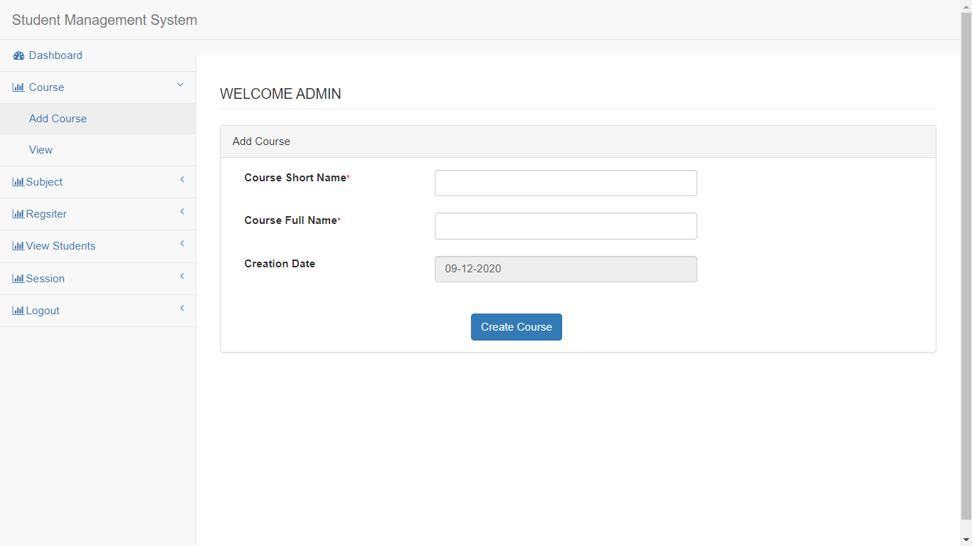
Snapshots: Home Page

Slide 9
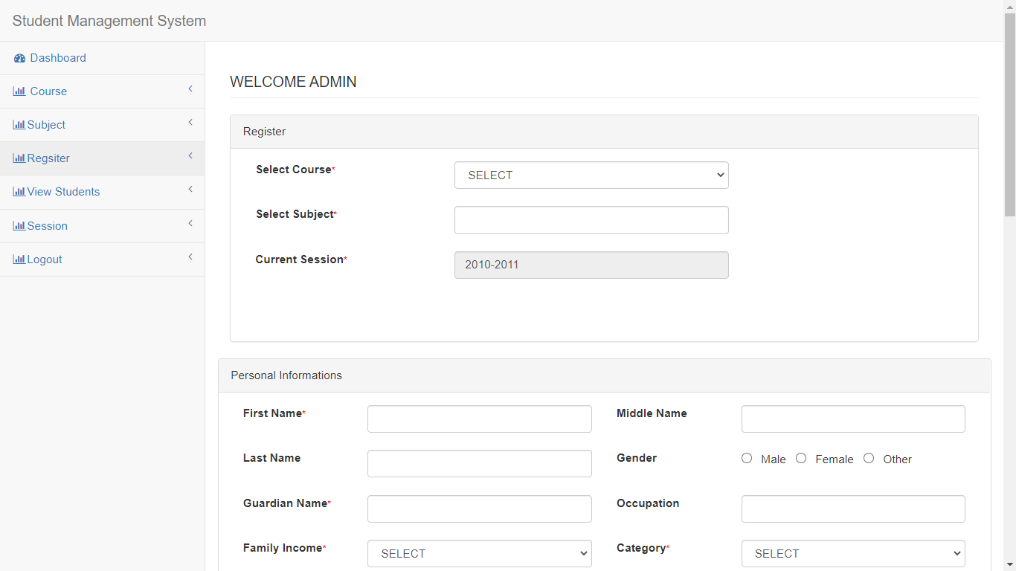
Snapshots: Add Student Page

Slide 10
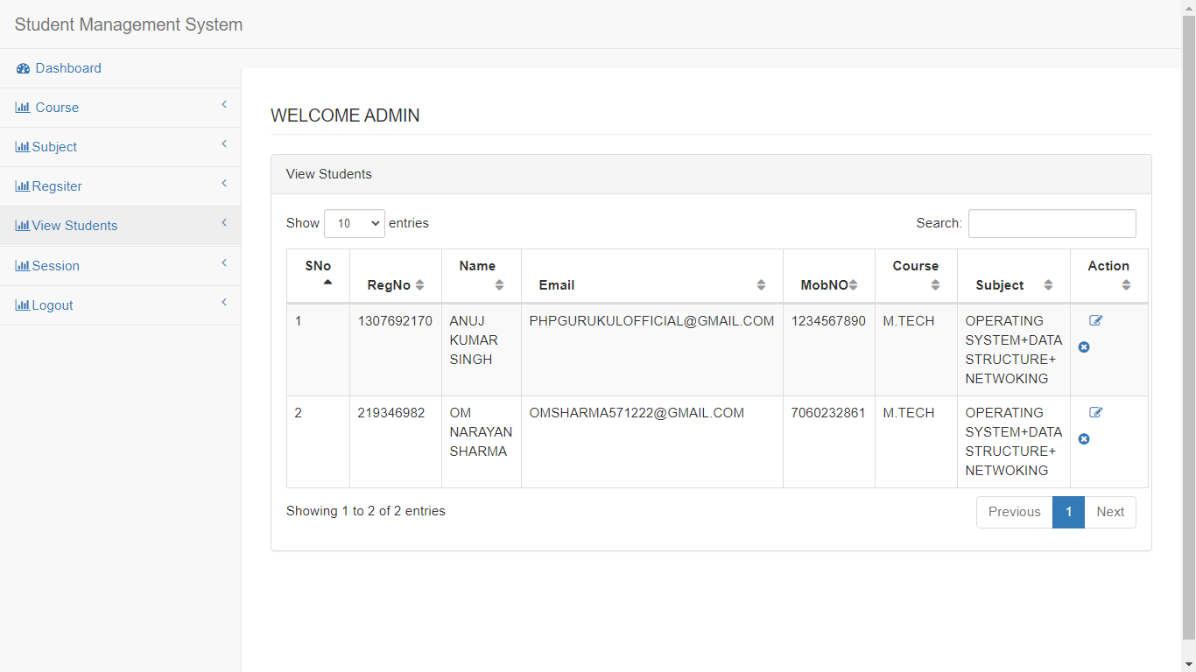
Snapshots:View Student Details

Slide 11
Snapshots: Add Course

Slide 12
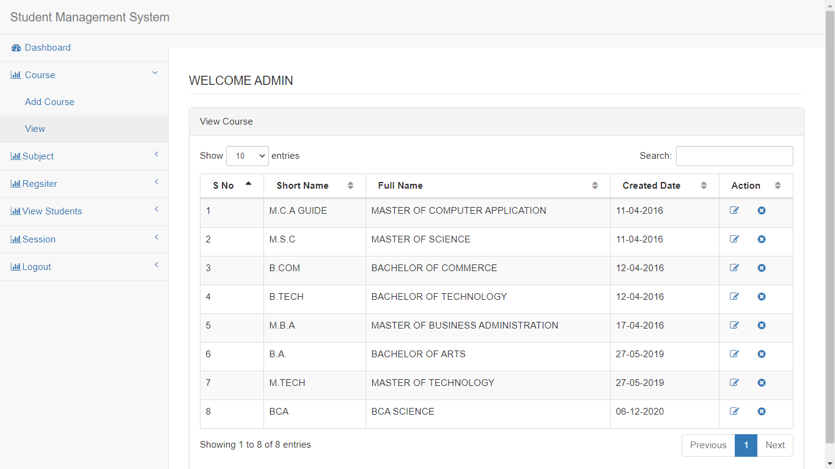
Snapshots: View Course Details

Slide 13
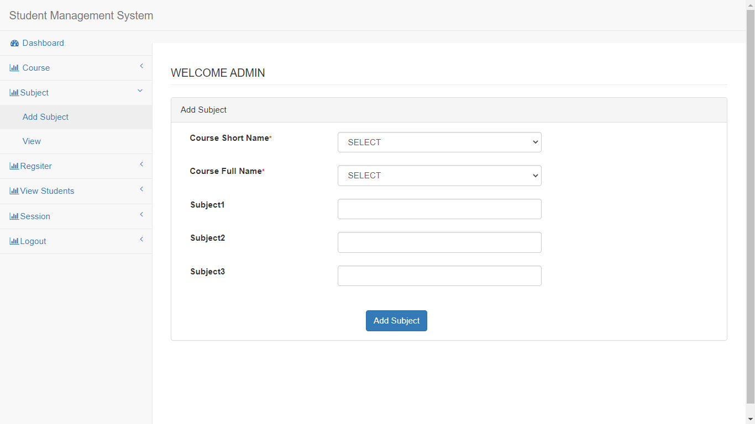
Snapshots: Add Subject

Slide 14
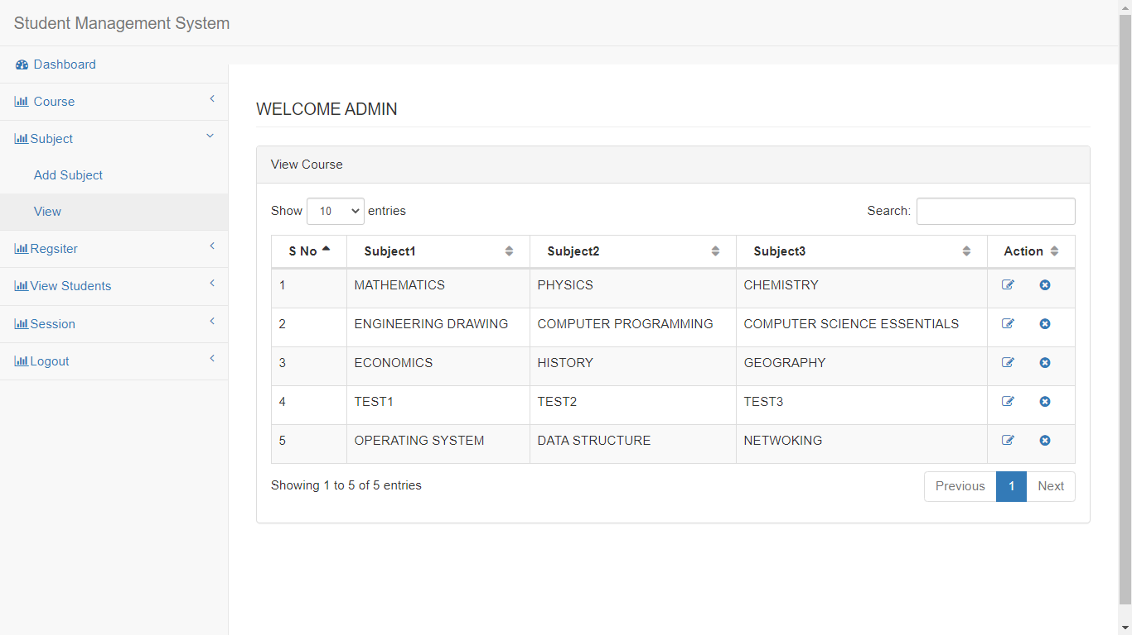
Snapshots: View Subject Details

Slide 15
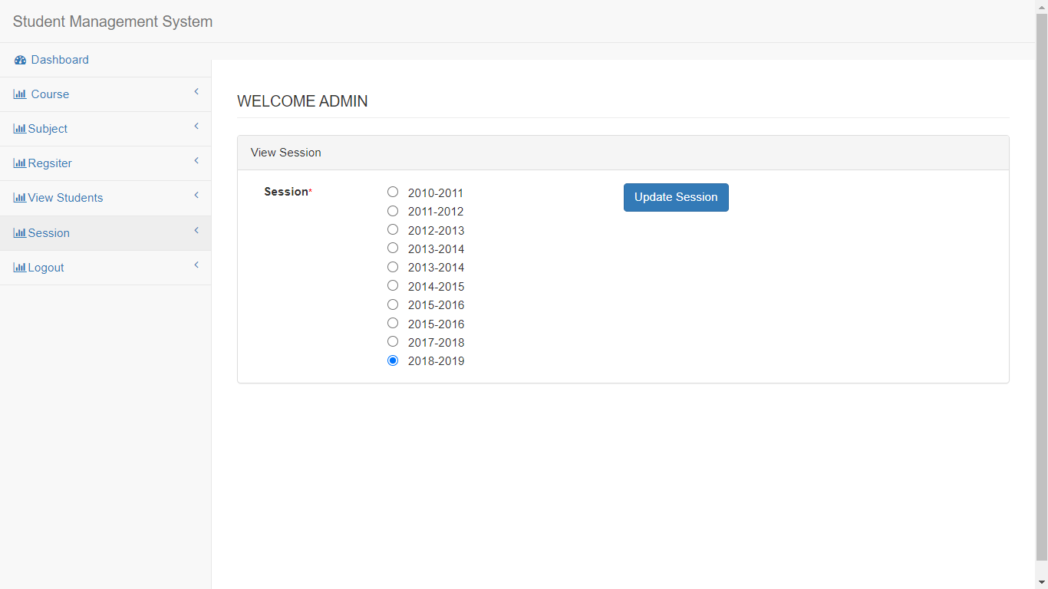
Snapshots: Sessions Page

Slide 16
Future Work
Add Student Attendance in future
In future we give update that adding particular marks of term exam
Add different types of payment mode.

Slide 17
Conclusion
Student Management System can be used by educational institutions to maintain their student records easily.
This system helps in maintaining the information of Student/ Course/Subject record of the organization.
It can be easily accessed by the admin and kept safe for a long period of time without any changes.
All these problems are solved by this project.

Slide 18
Project link Student record management system

Slide 19


